Slide 1
CCBR1040
Single-cell RNAseq/TCRseq

Slide 2
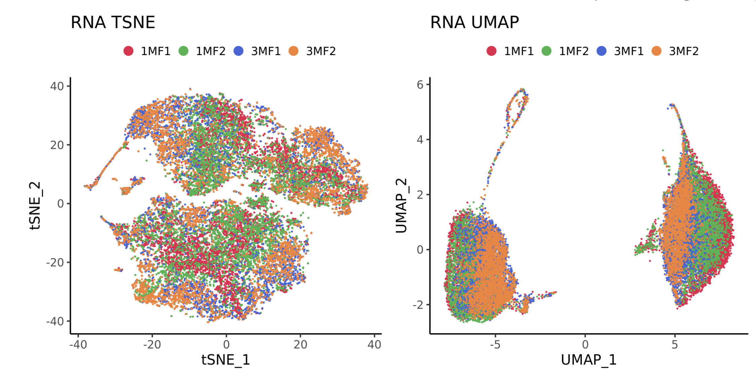
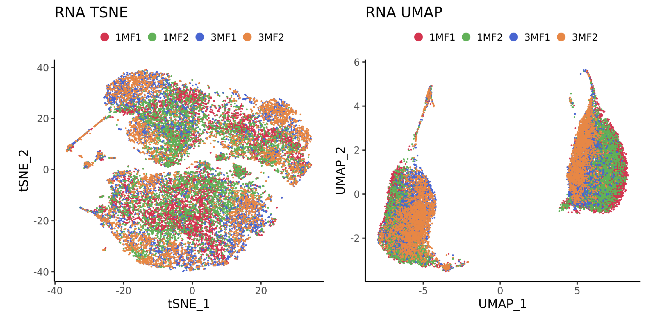
Before integration(batch correction)
After integration(batch correction)

Slide 3
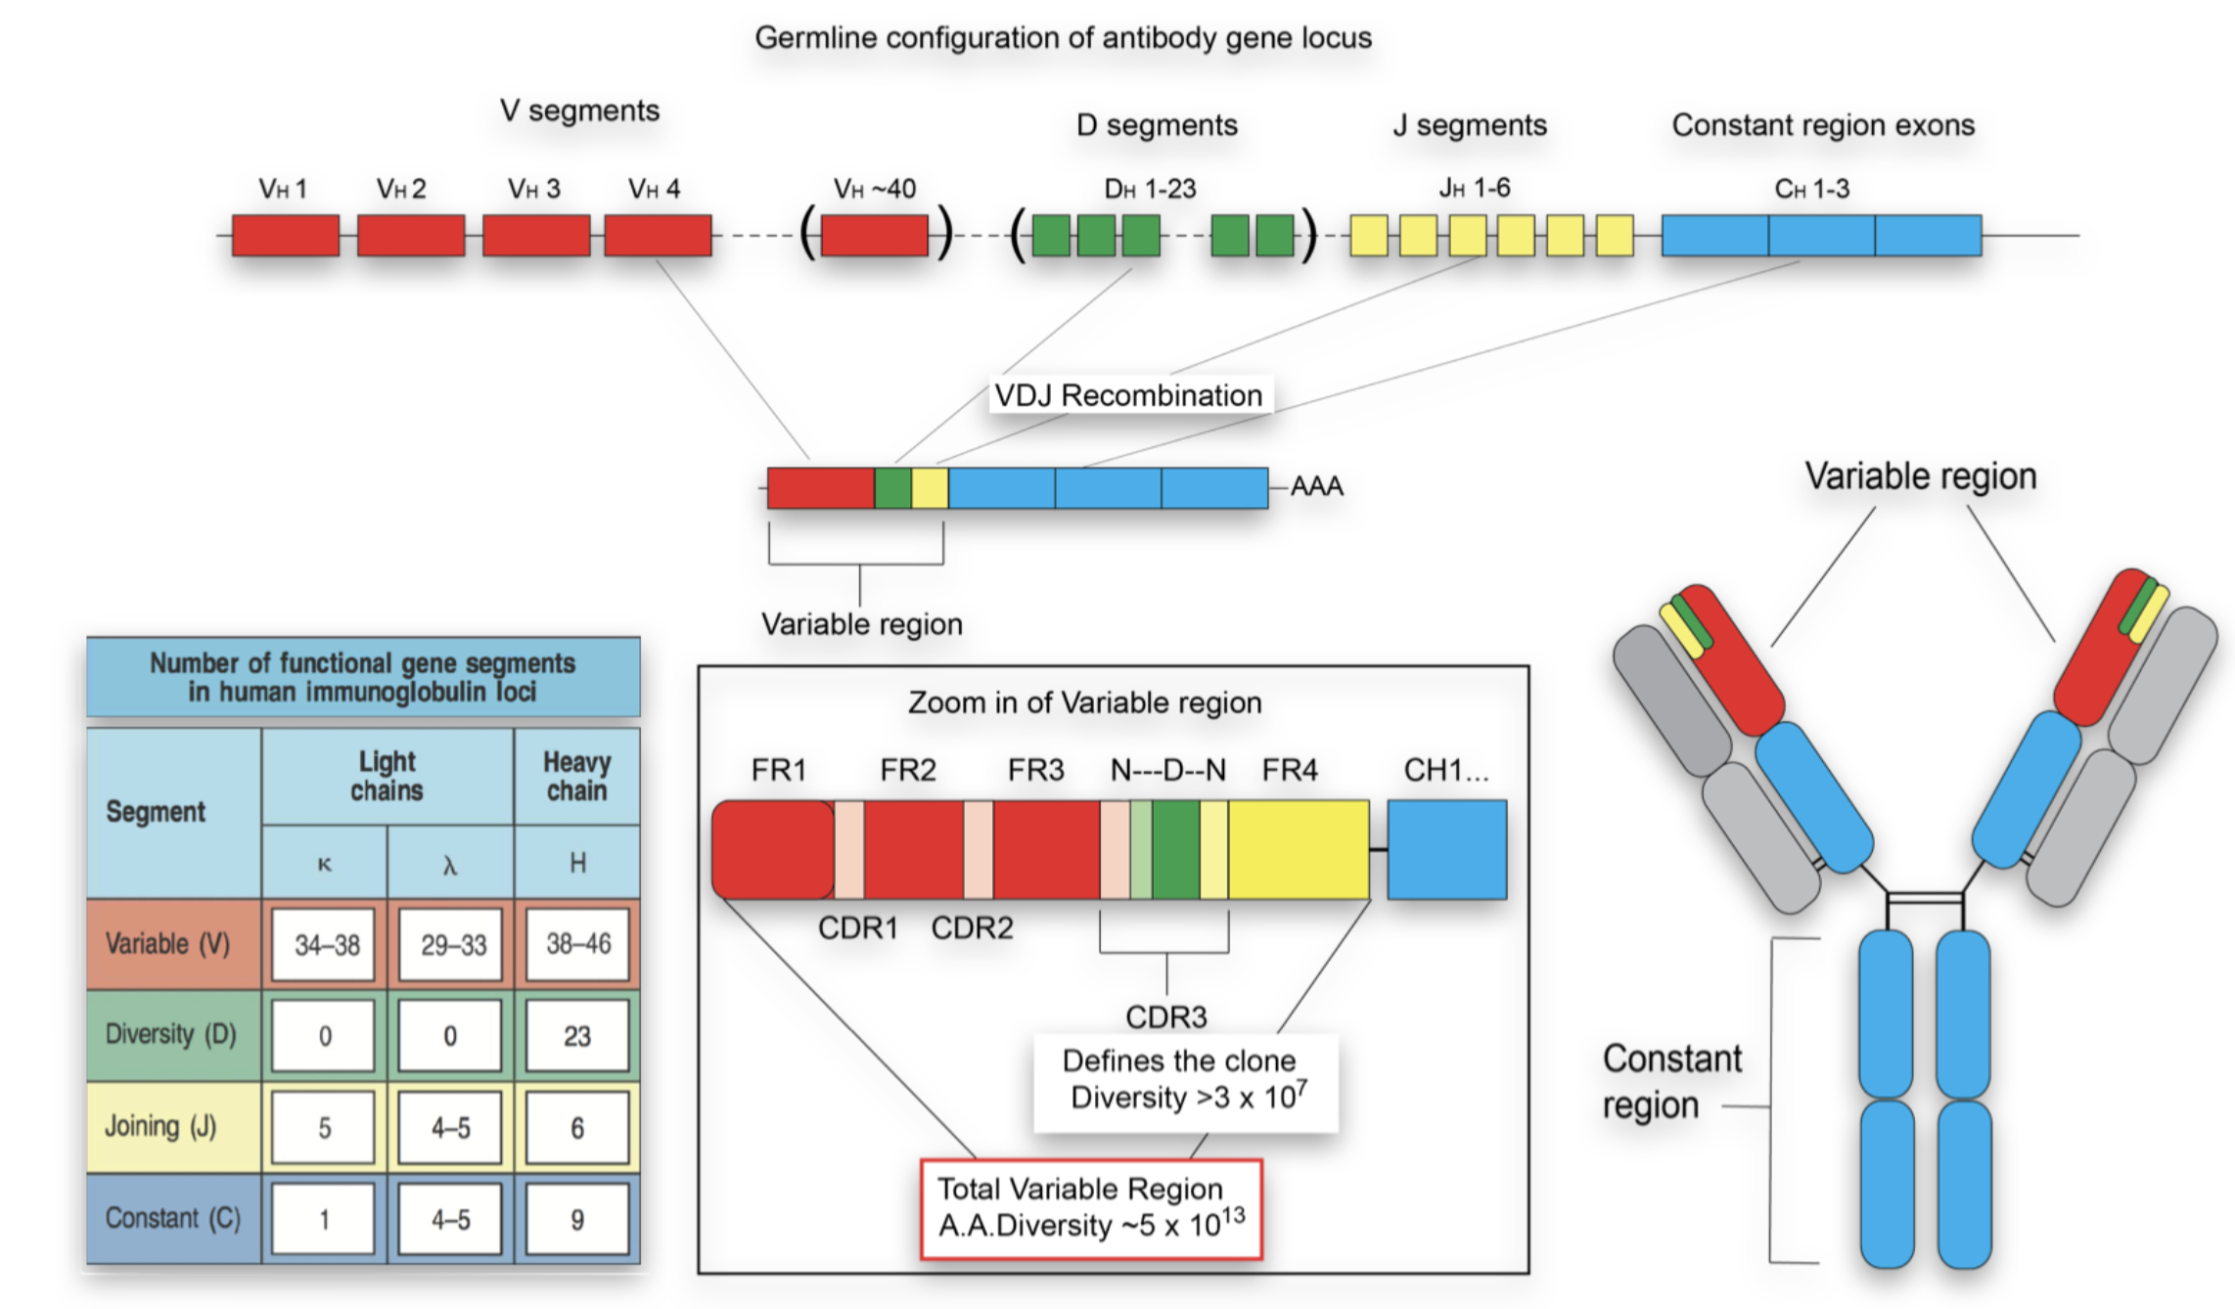

Slide 4
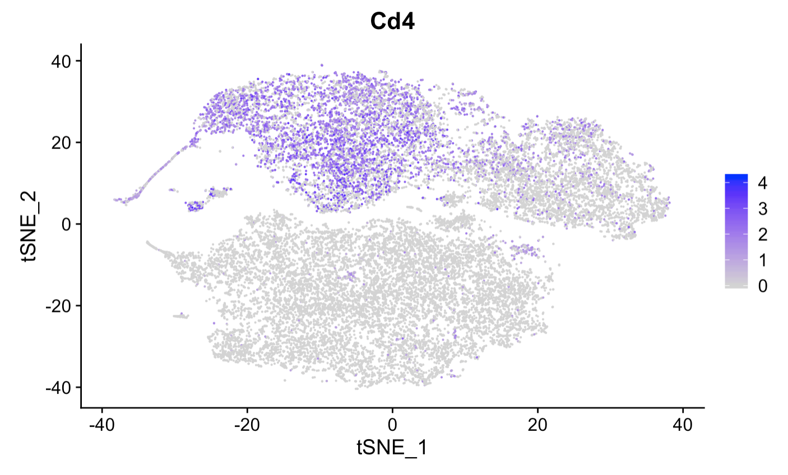
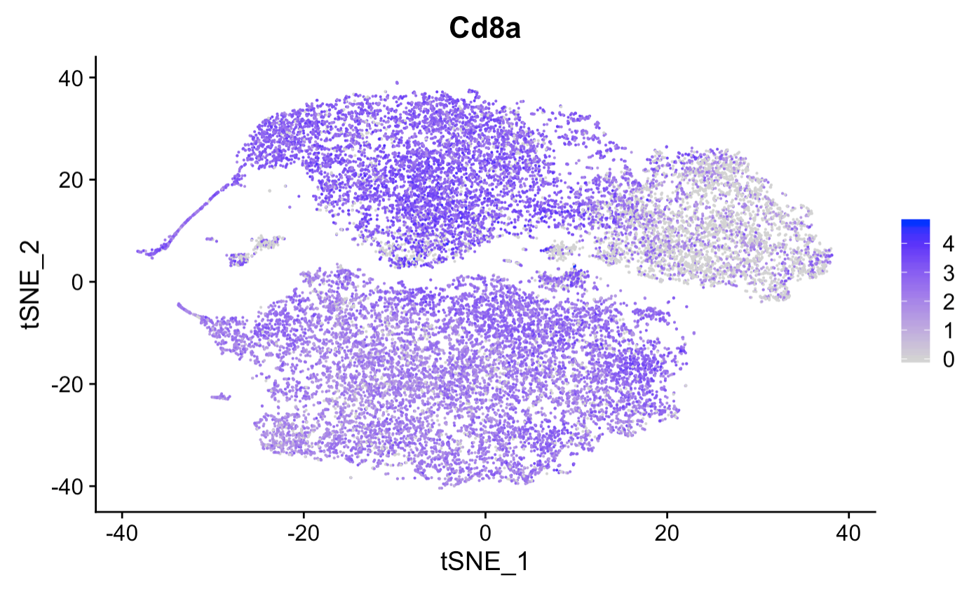
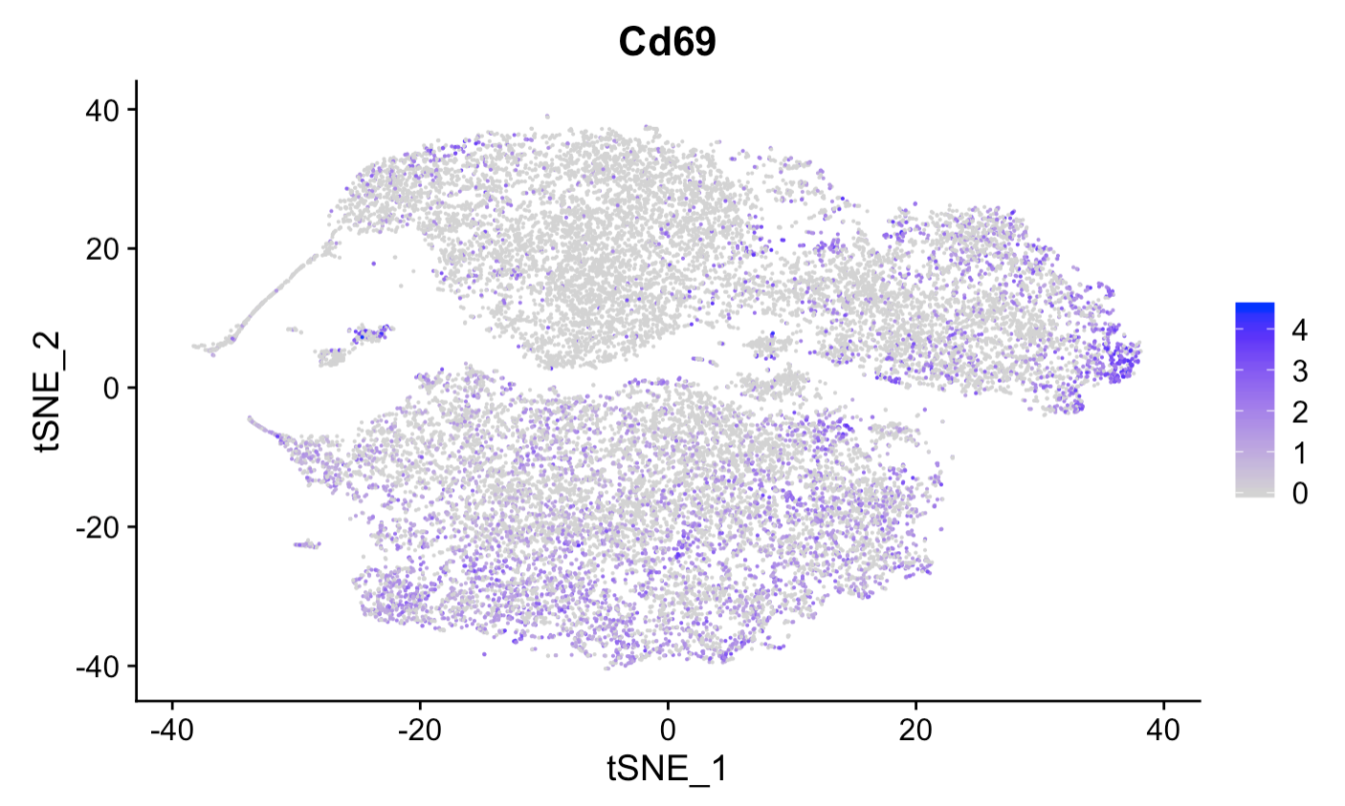
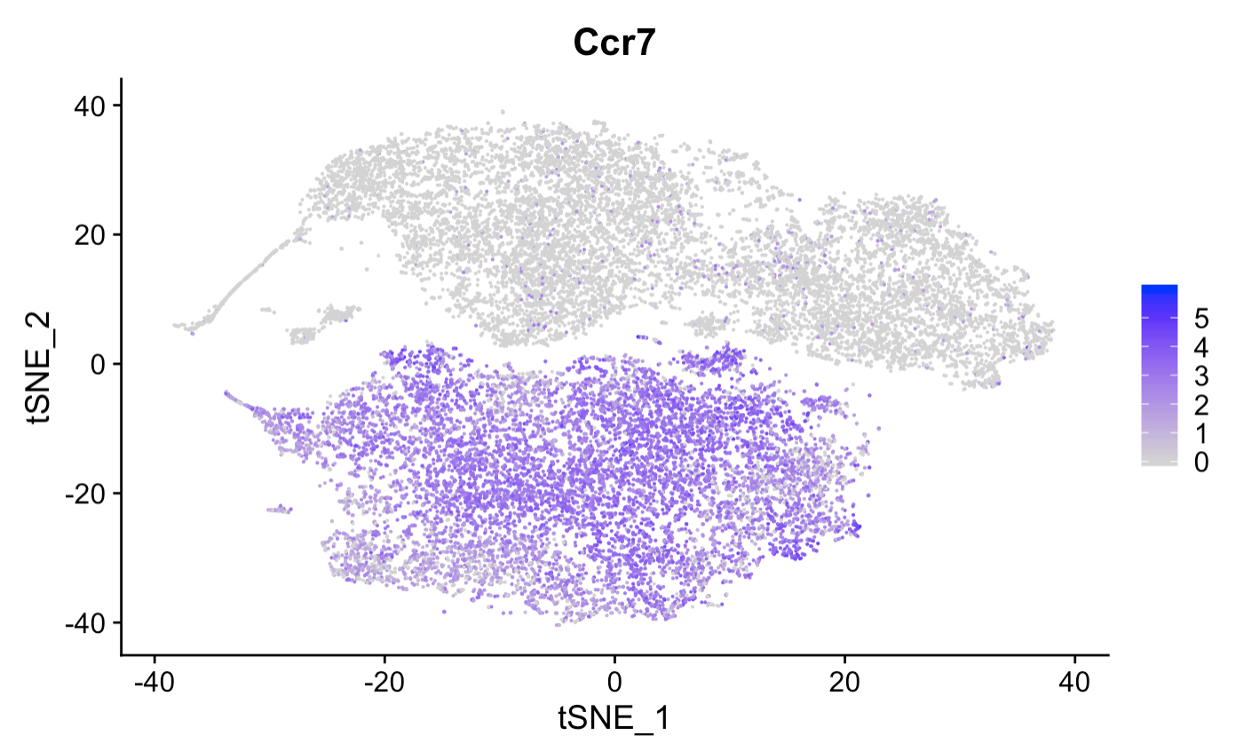

Slide 5
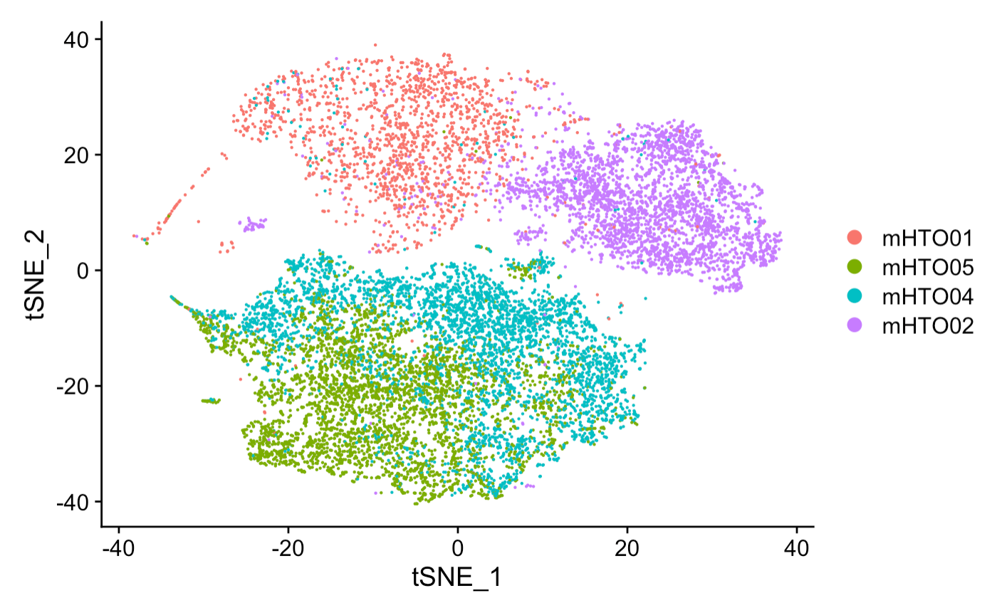
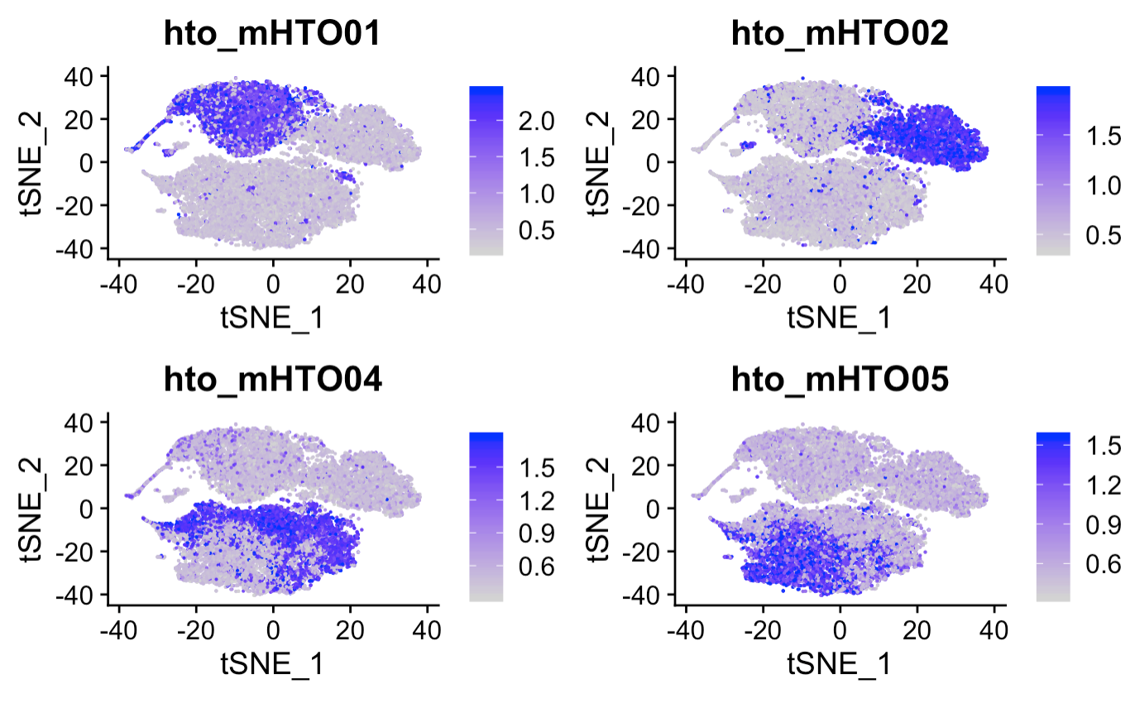

Slide 6
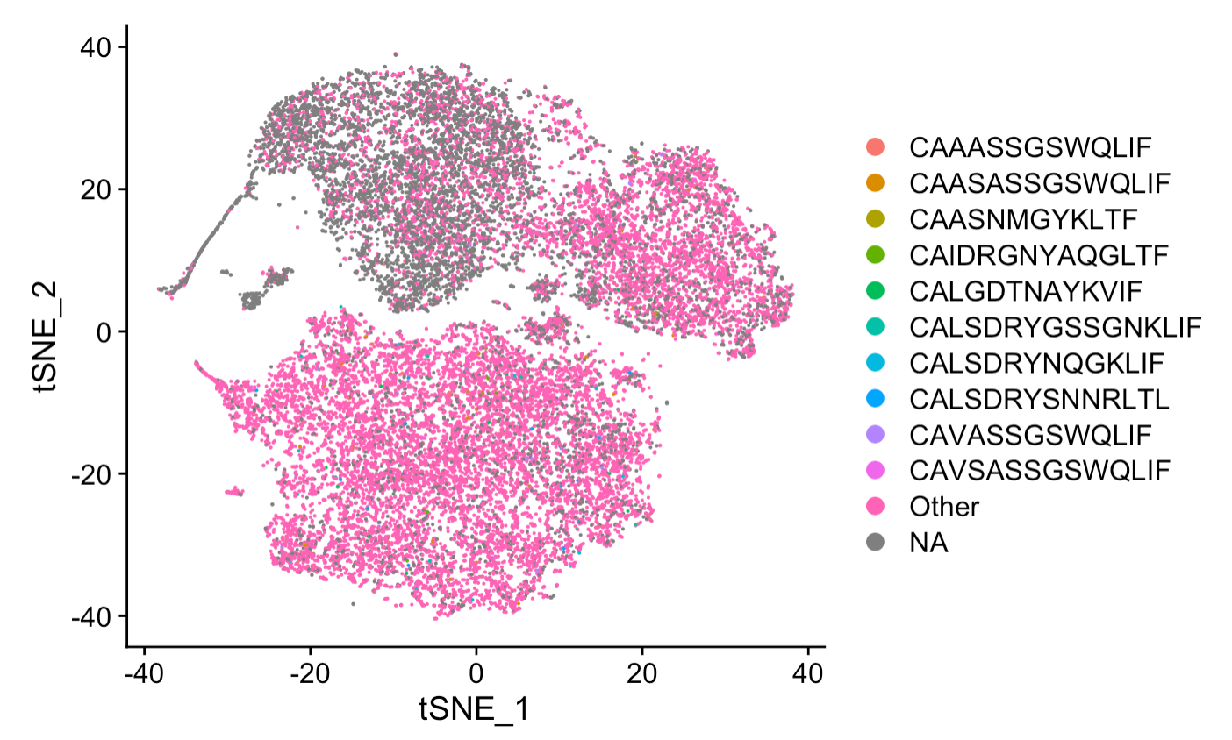

Slide 7
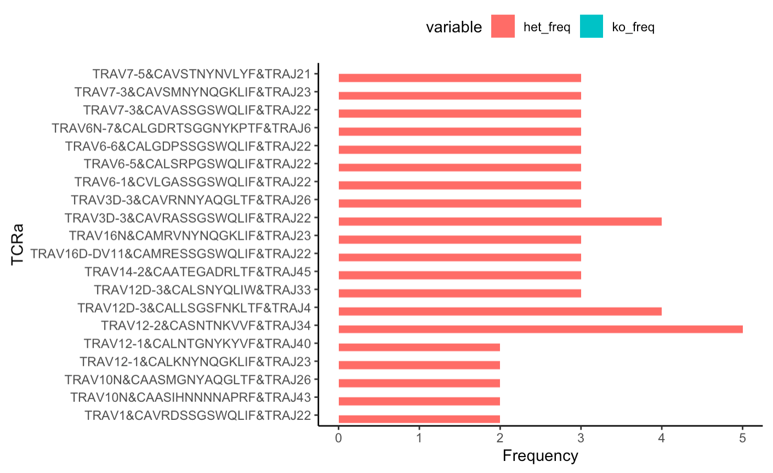
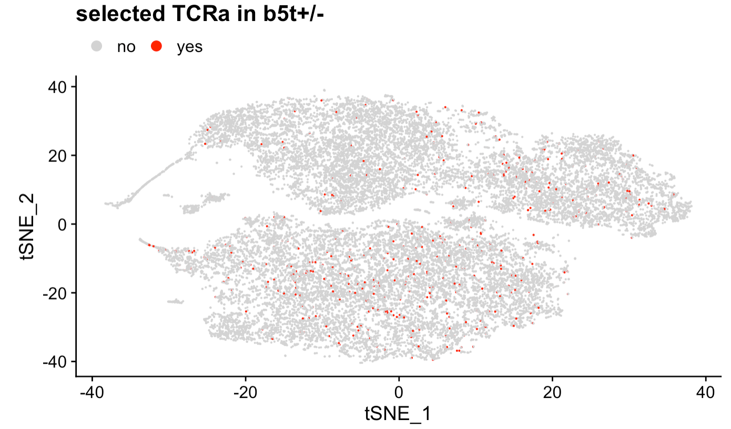
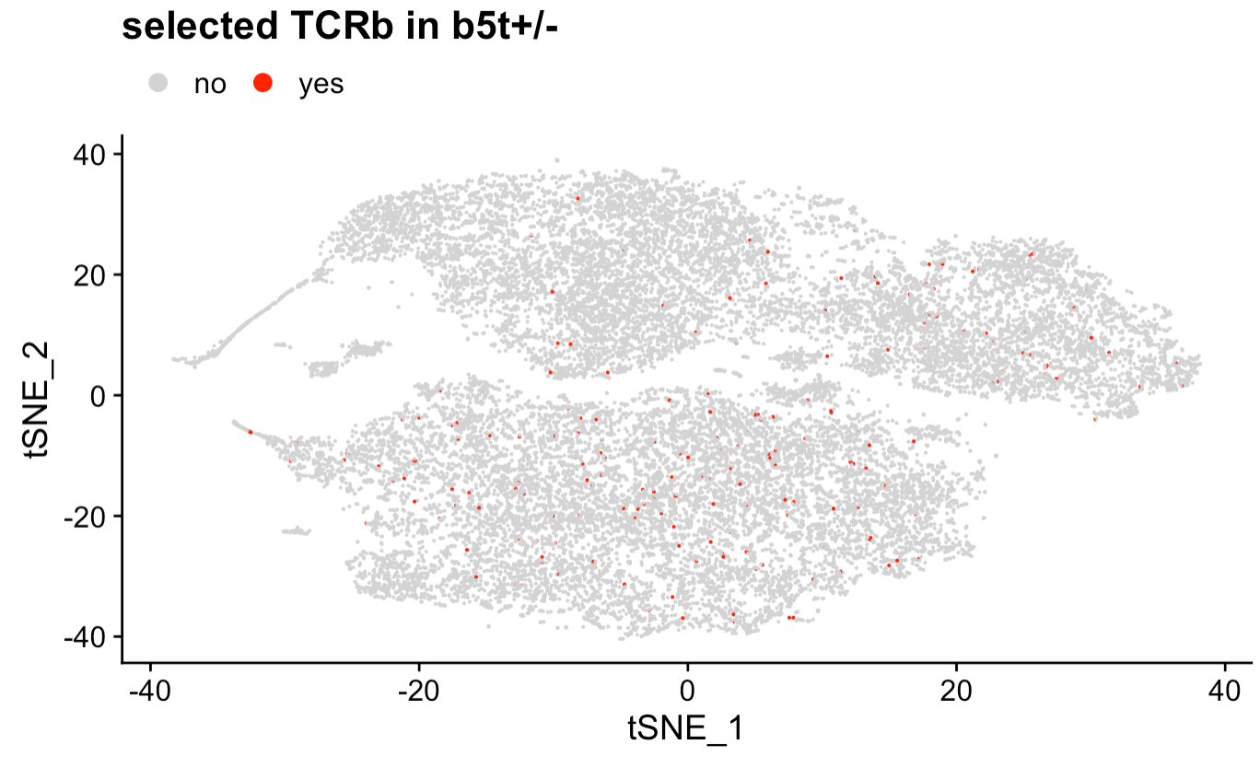
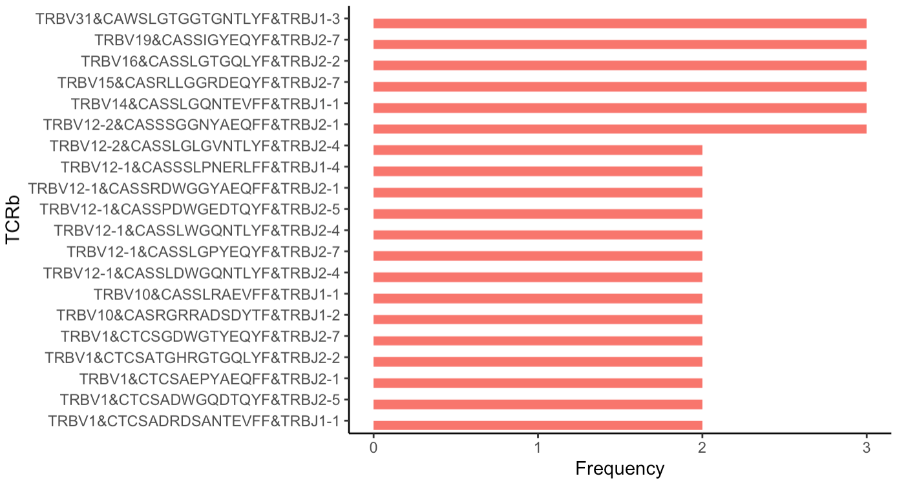

Slide 8
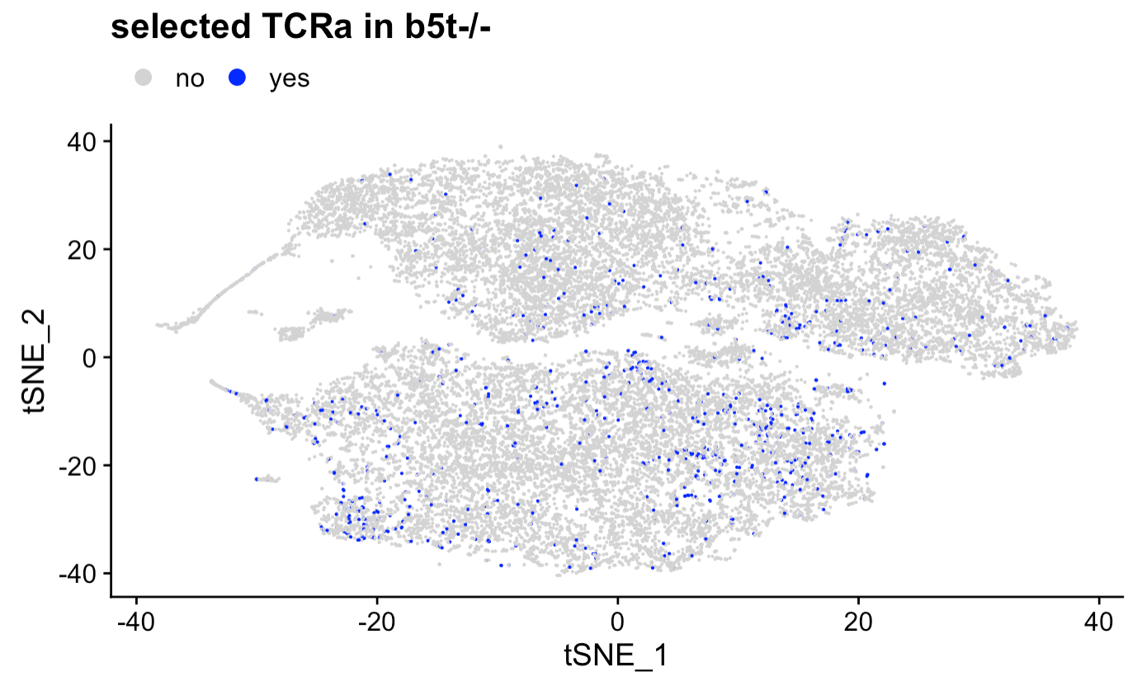
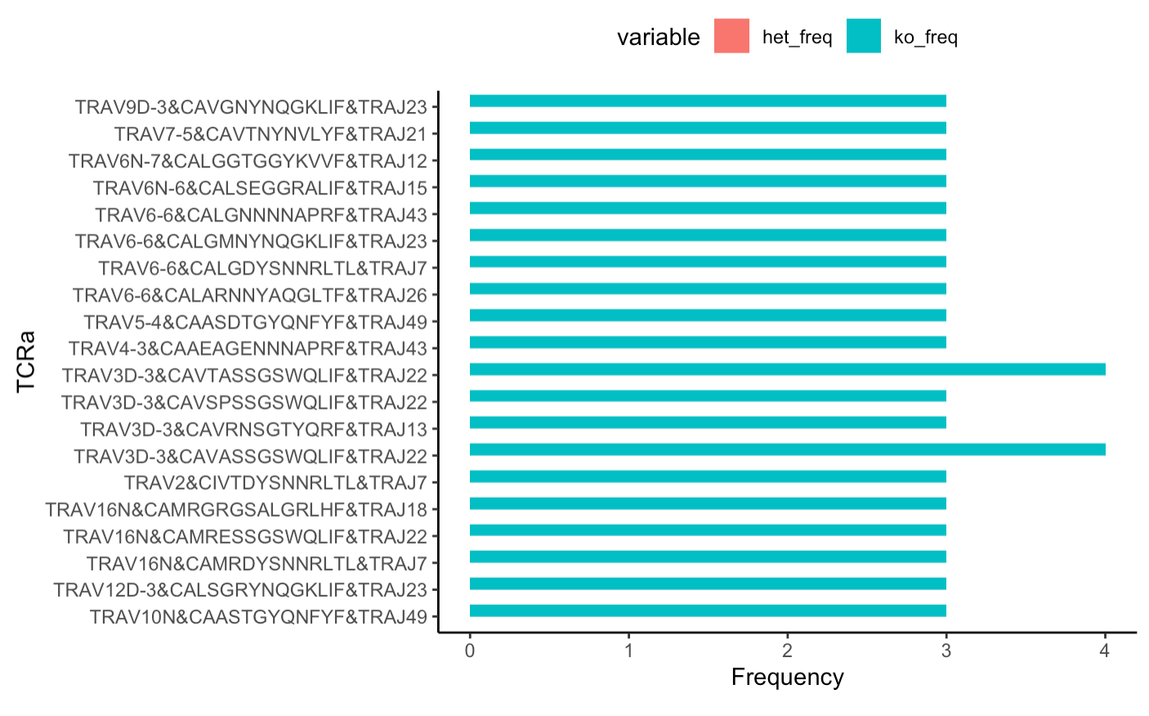
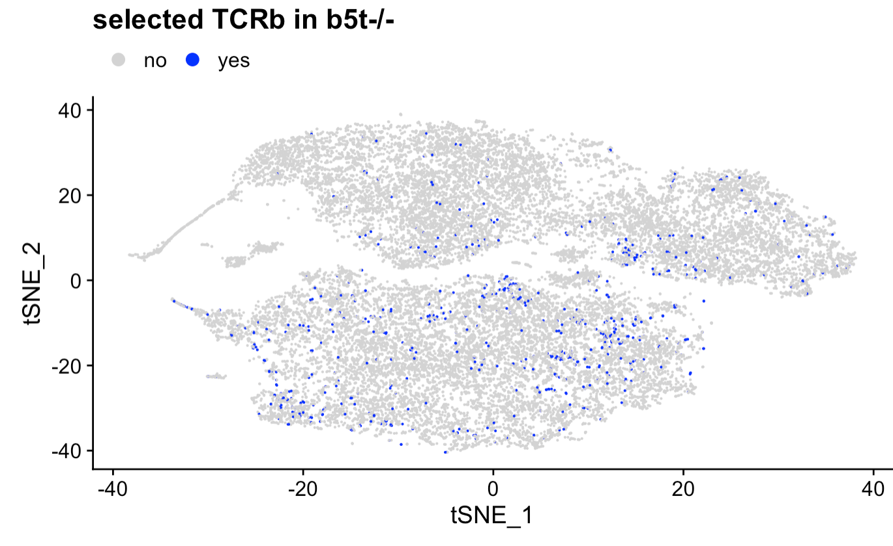
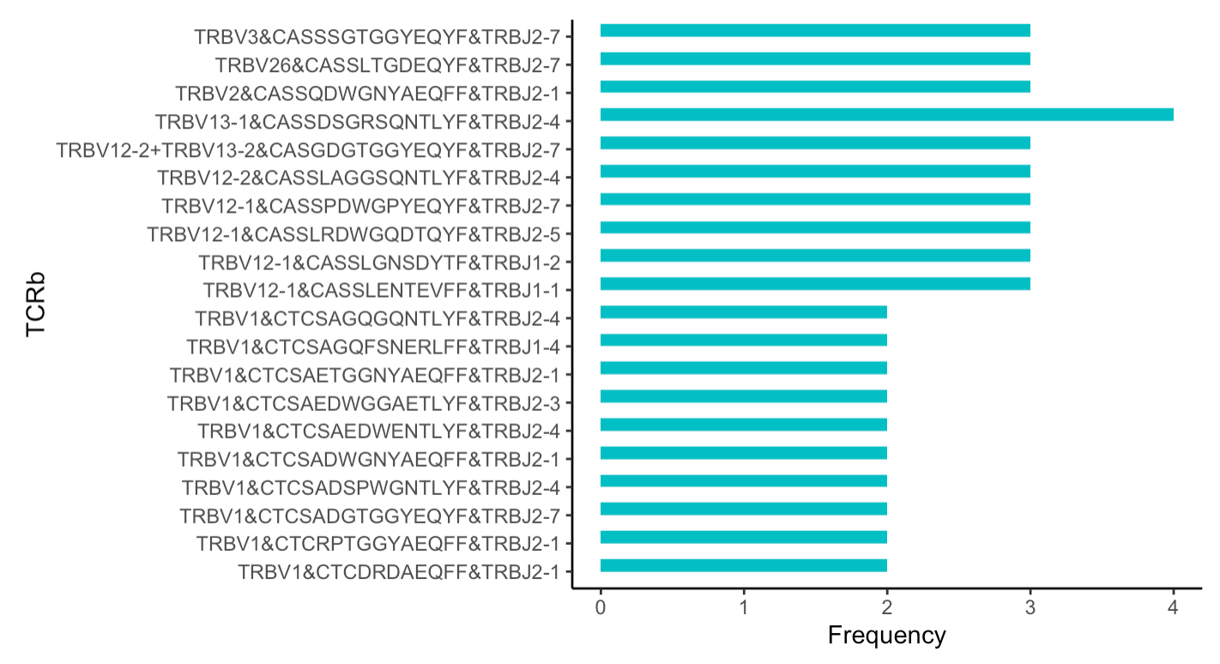

Slide 9
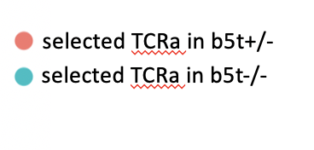
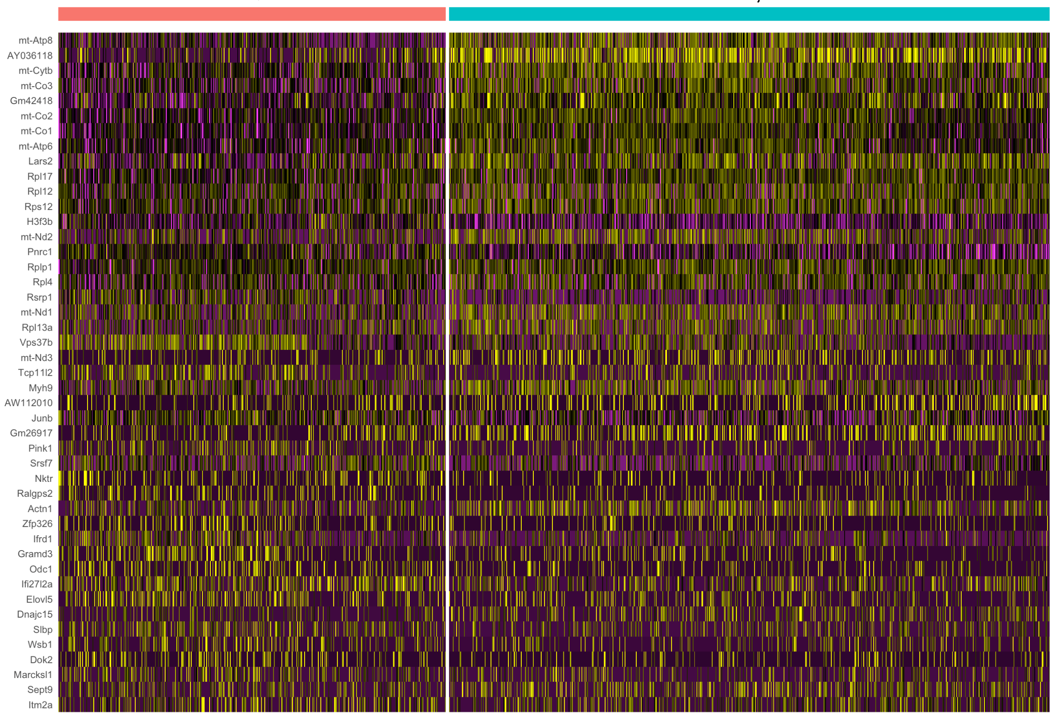
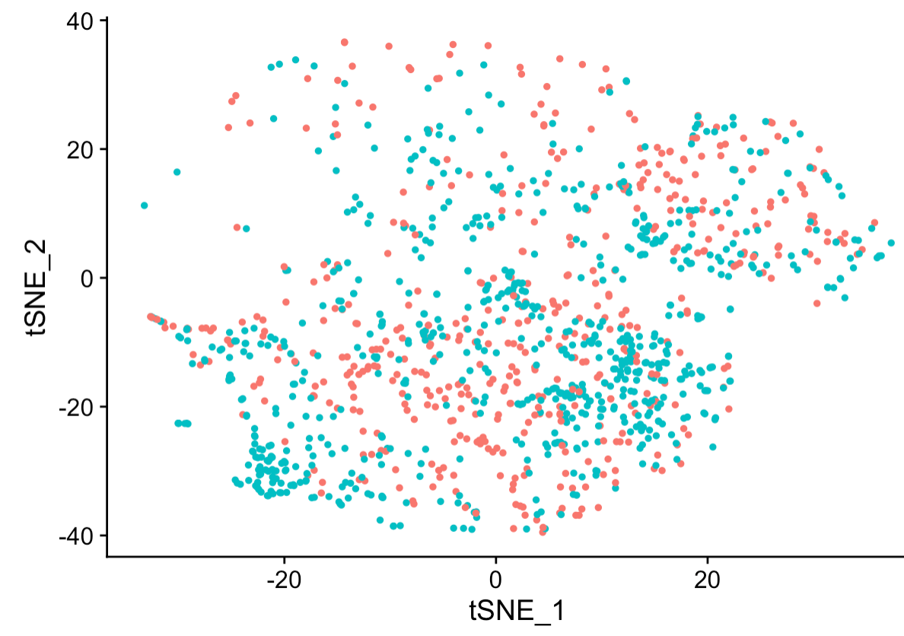

Slide 10
HT002
(newly generated cells)
HT004/HT005
(downstream cells)
TCR alpha/beta in HT004/005 must be detected in TCR alpha/beta in HT002
development
no detection of overlap
in TCR alpha and/or beta
(sample size is too small)
no difference
in TCR alpha and/or beta
(no selection during development)
Yousuke

Slide 11
HT002
(newly generated cells)
HT004/HT005
(downstream cells)
development
increase in clone size
(survival during development)
reduction in clone size
(negative selection during development)
Yousuke

Slide 12
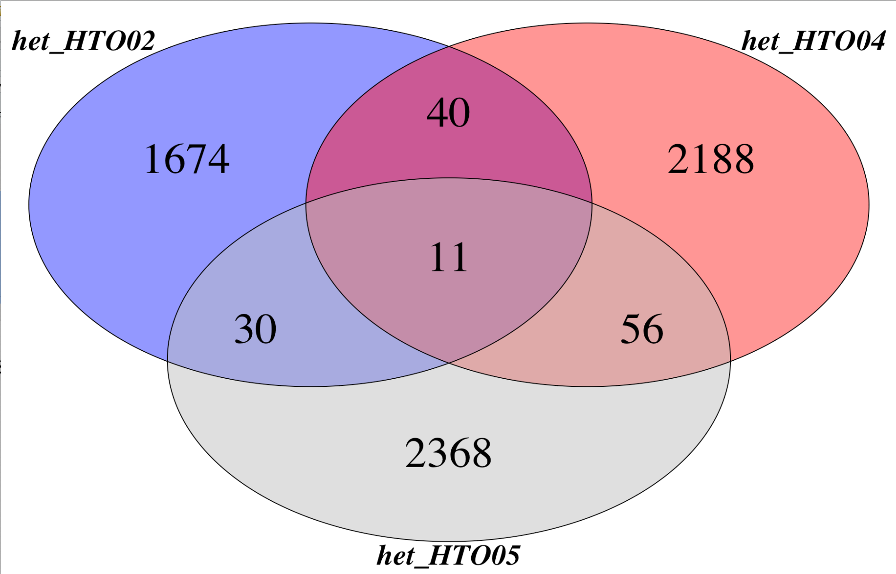

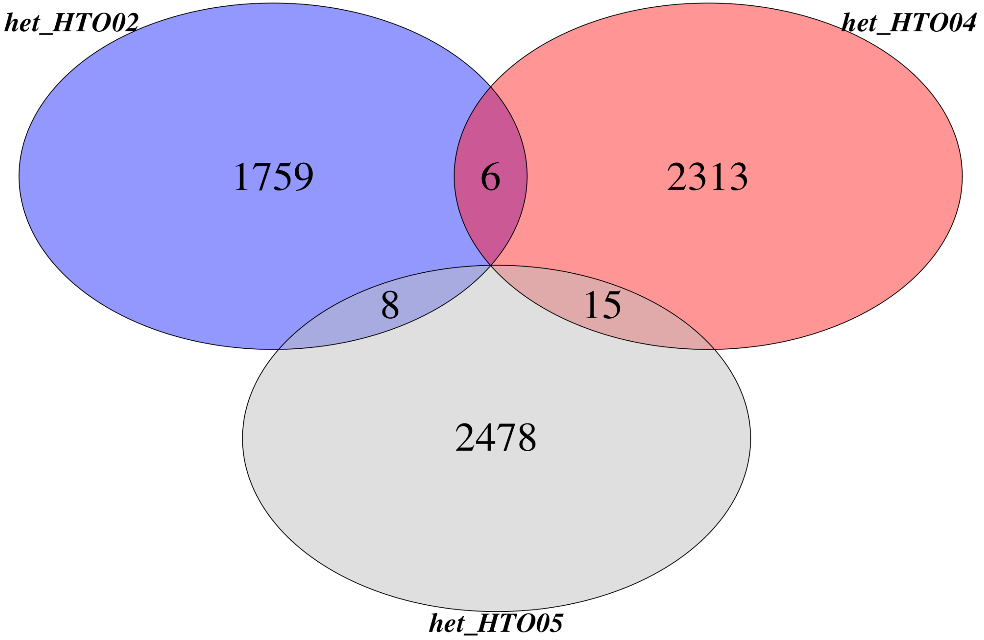
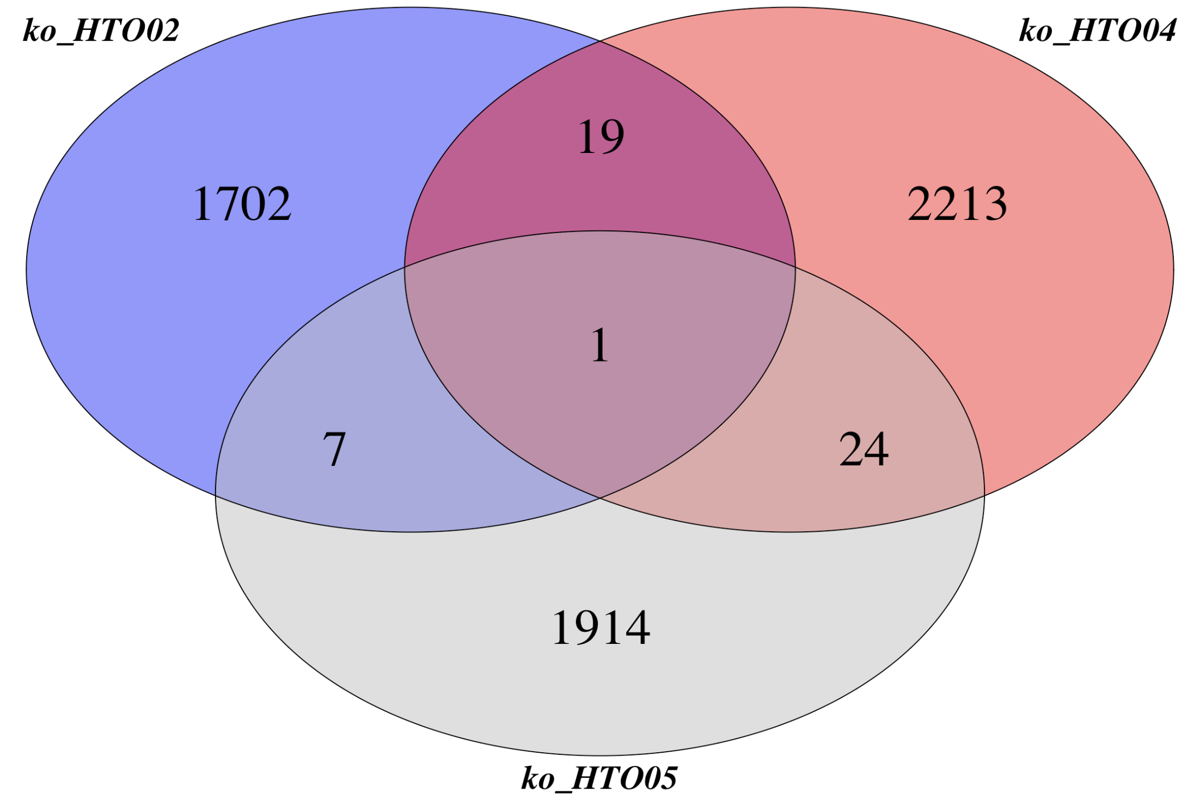
TCR alpha
TCR beta

Slide 13
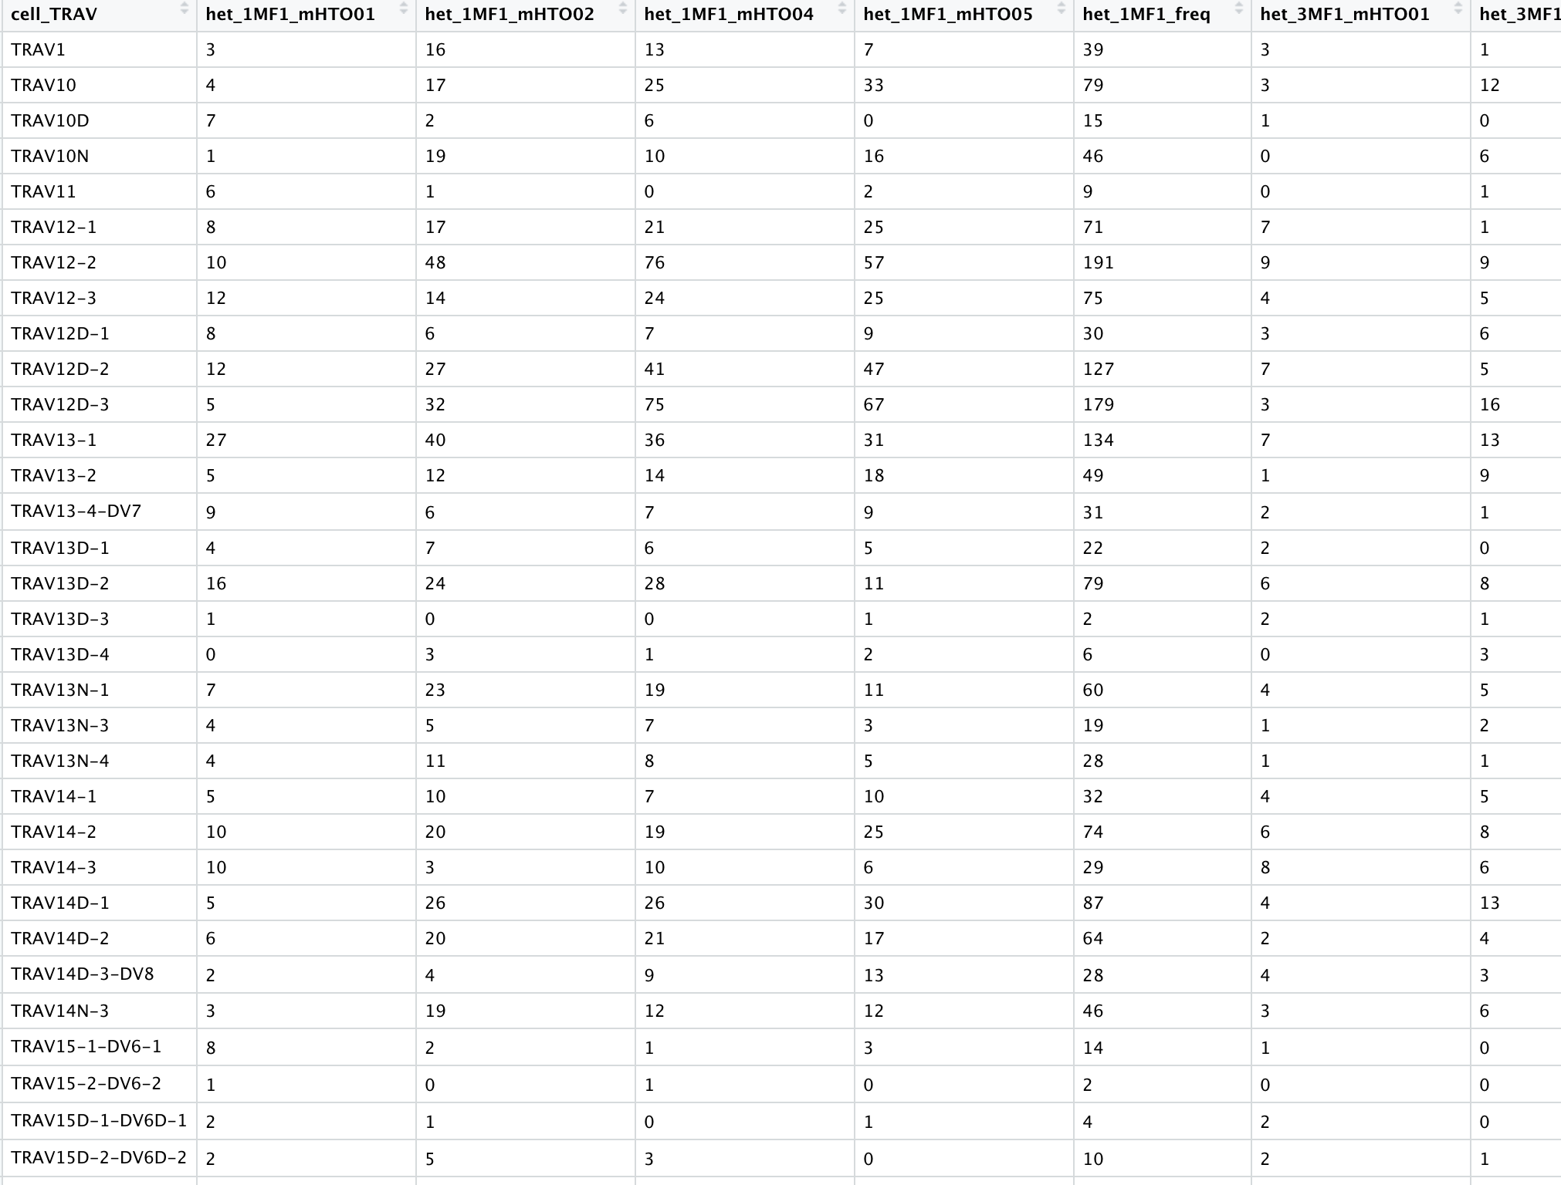

Slide 14
 | TCRa | TCRb | TRAV | TRBV | TRAJ | TRBJ | Alpha CDR3 | Beta CDR3 | Alpha beta pair (clonal type
het_1MF1
het_3MF1
ko_1MF2

Slide 15
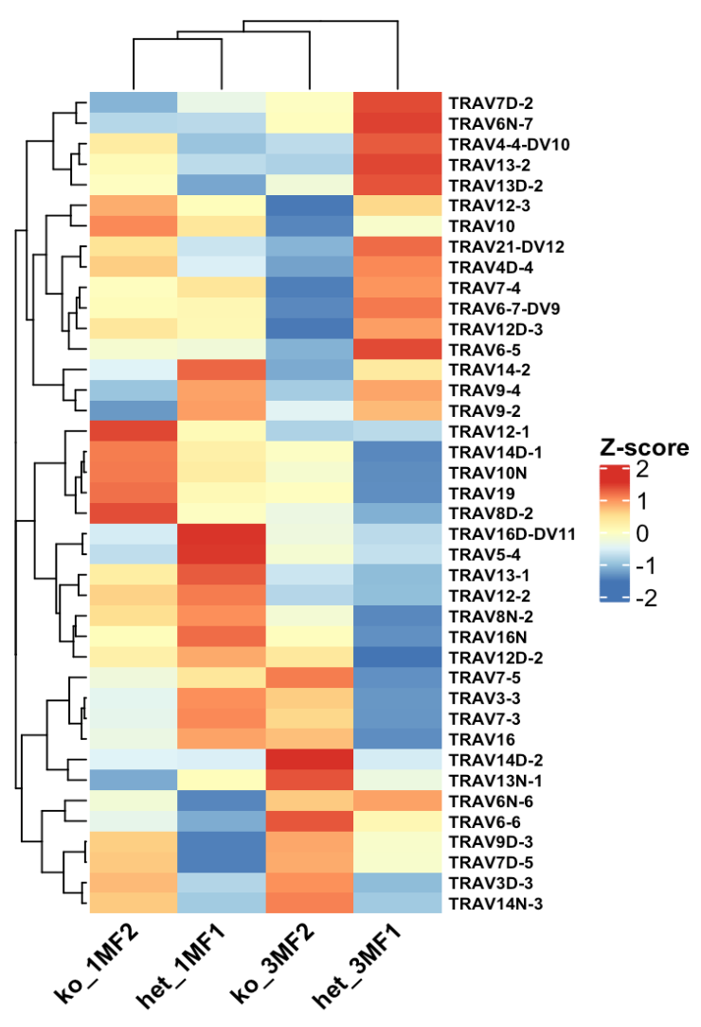
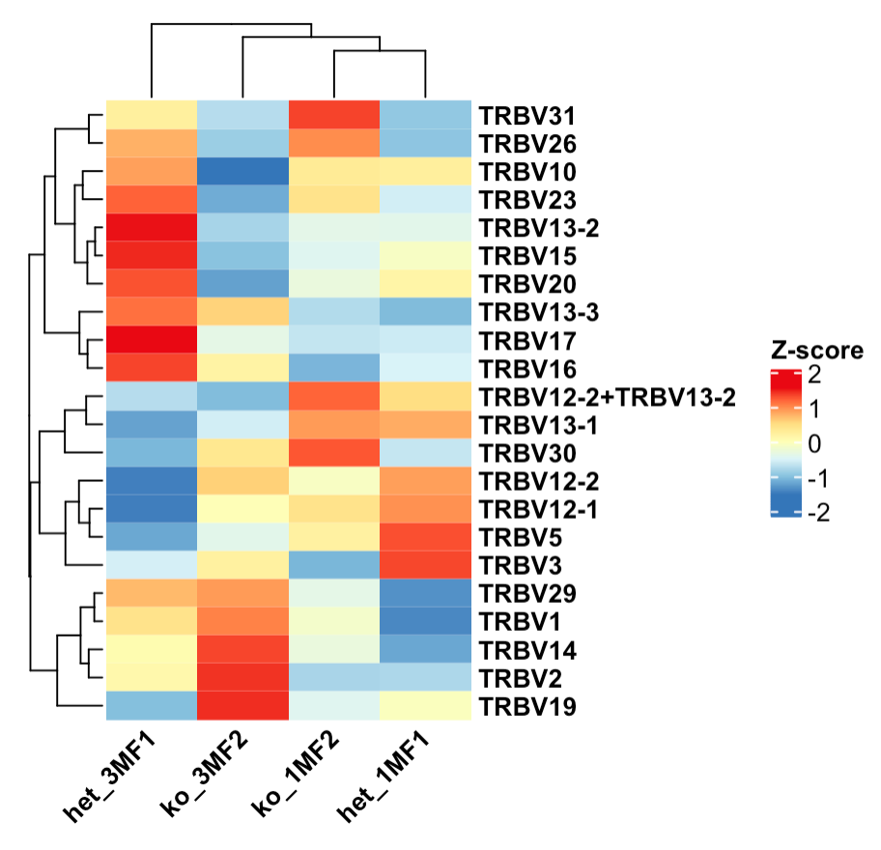
Alpha and Beta chain Variable (V) gene usage among samples. The heat map shows the gene usage proportion inside each sample for the V genes listed on the right of figure.

Slide 16
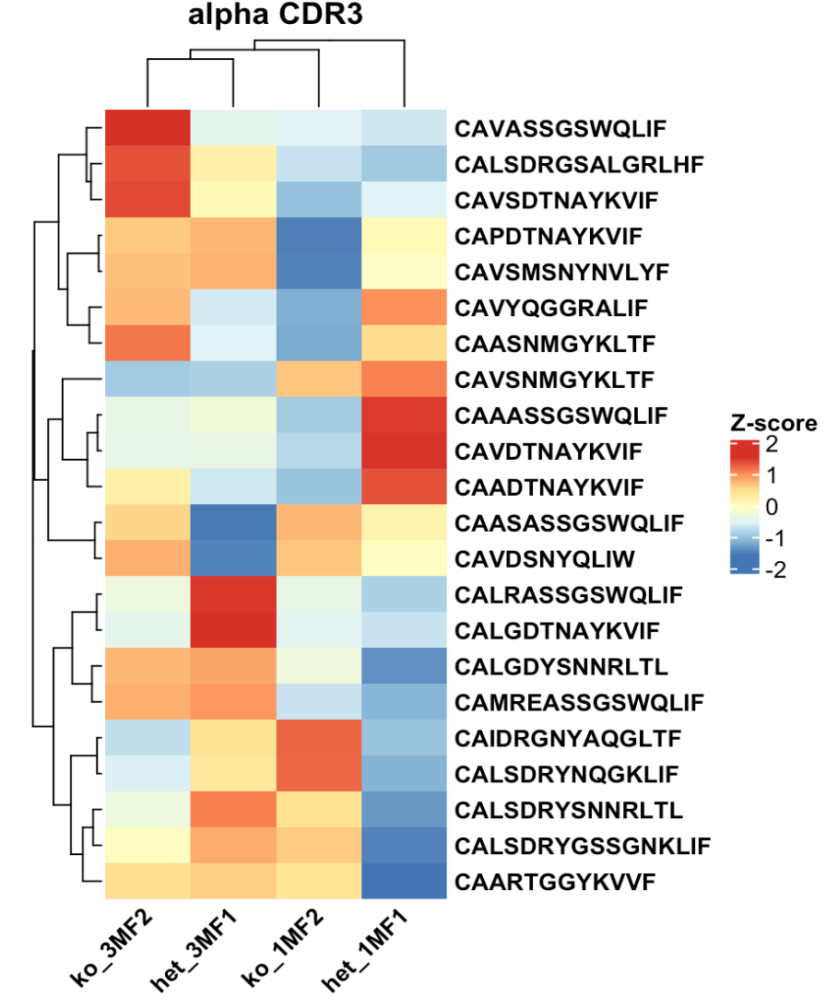

Slide 17
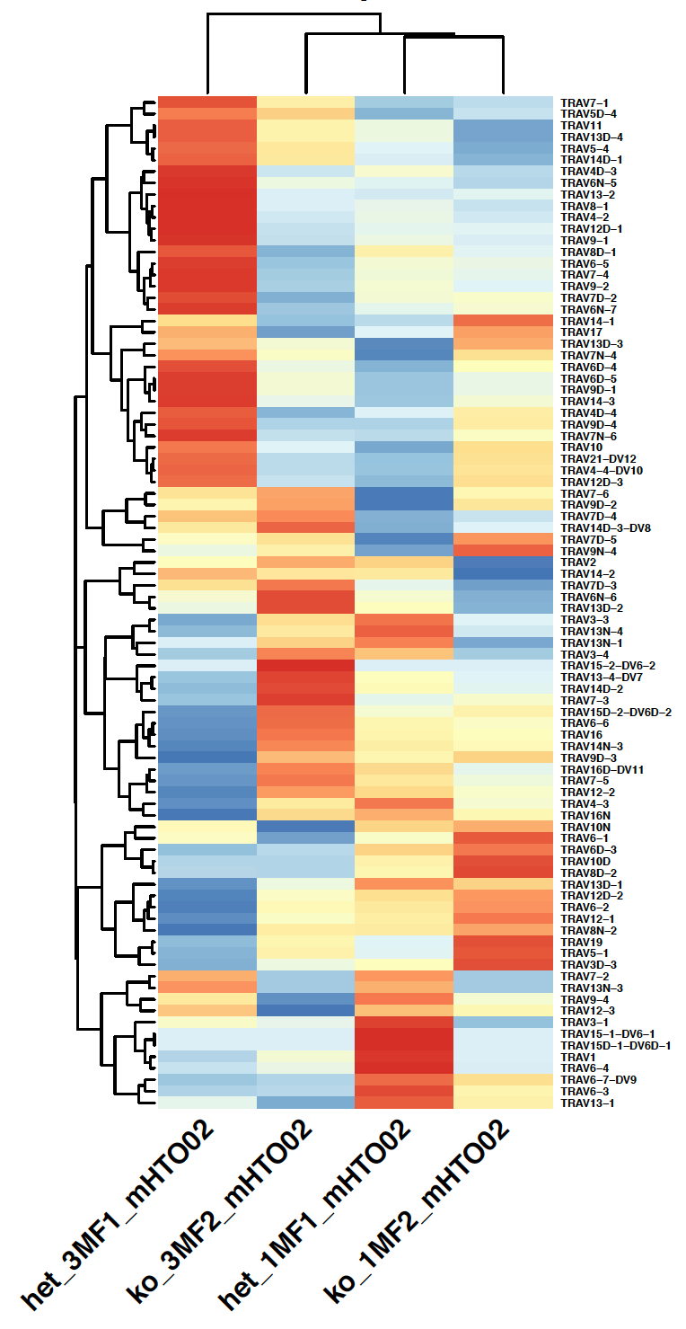
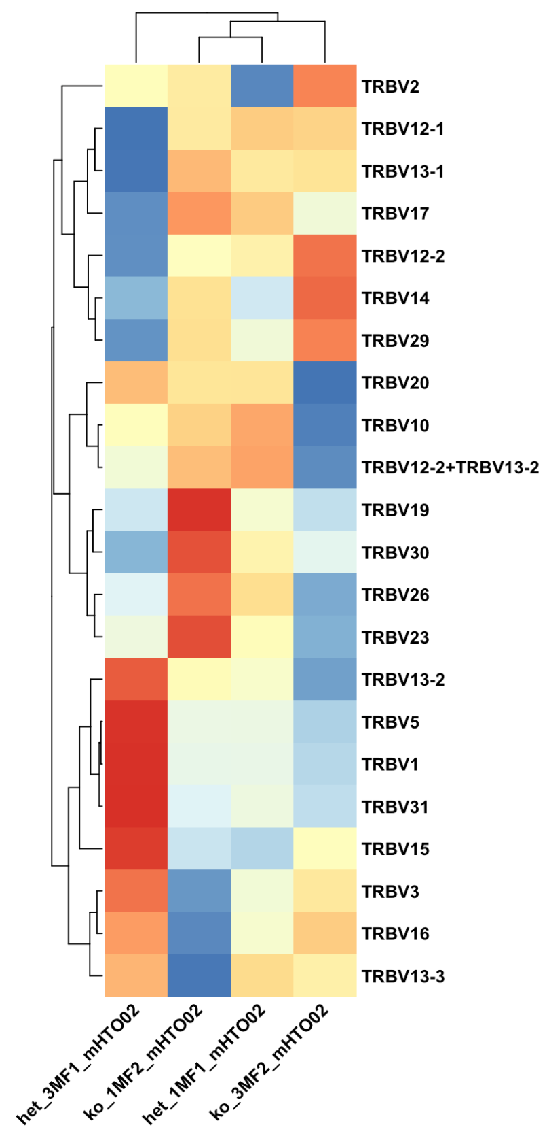
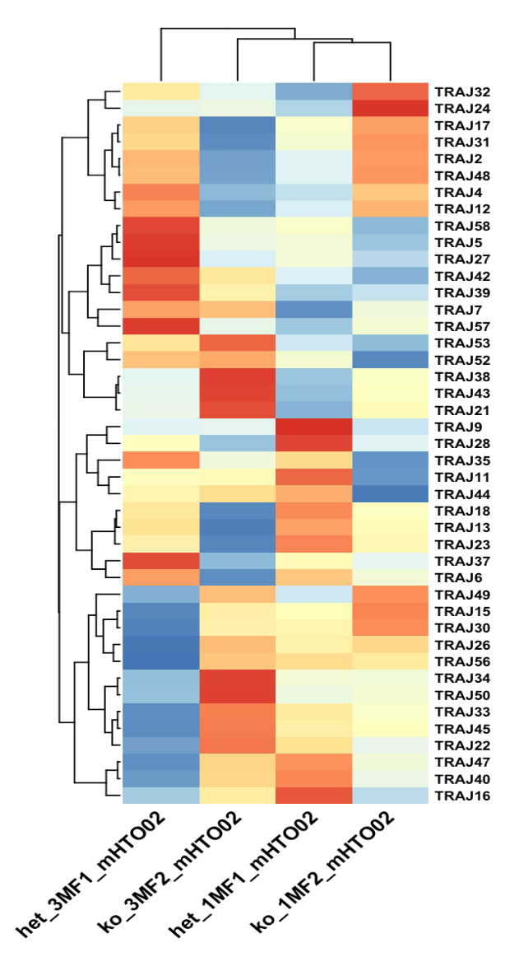
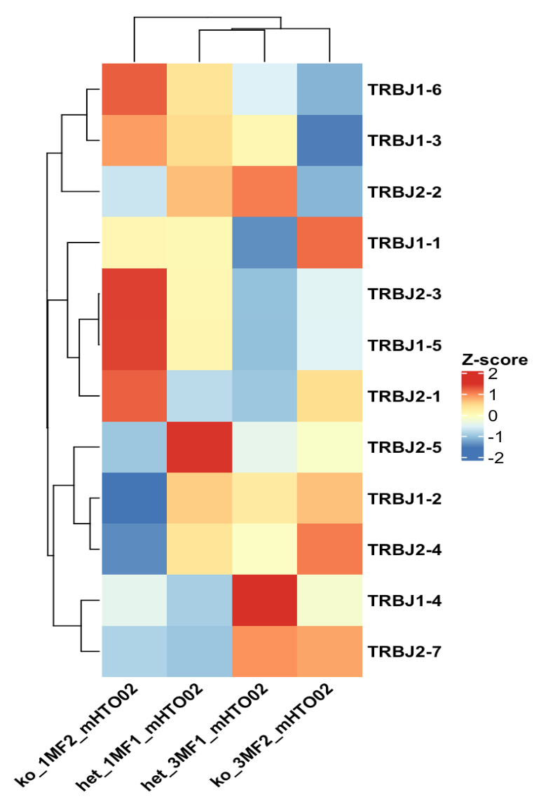

Slide 18
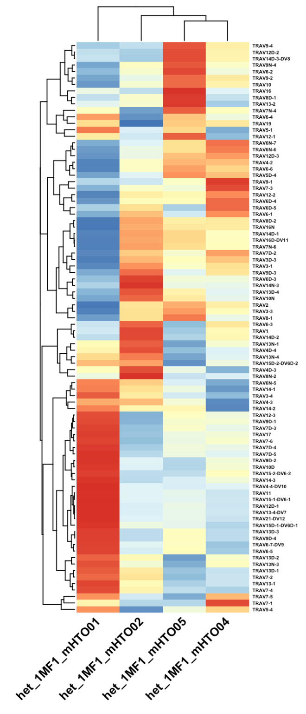
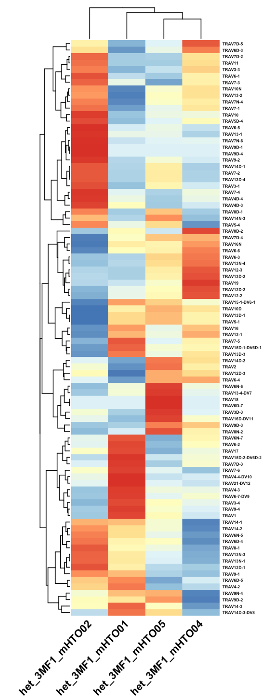
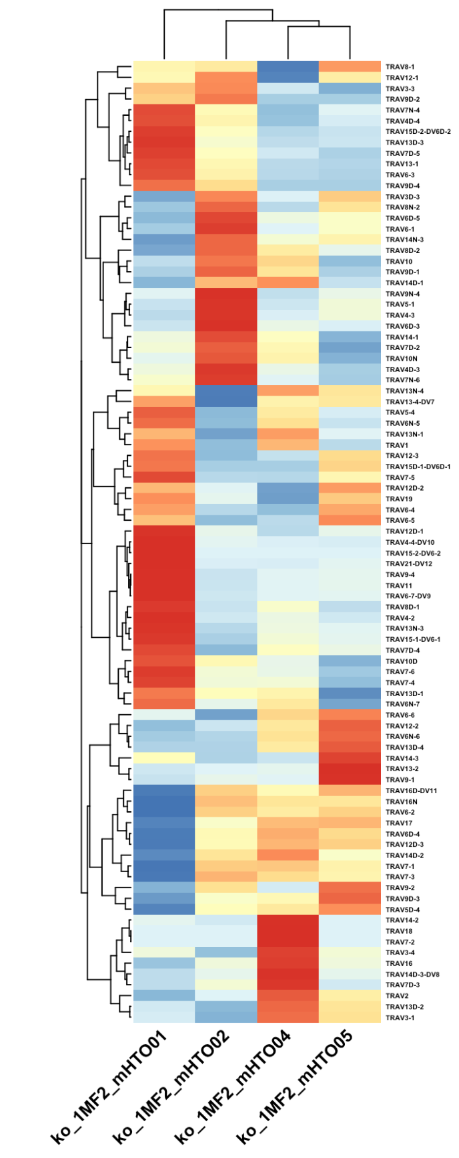
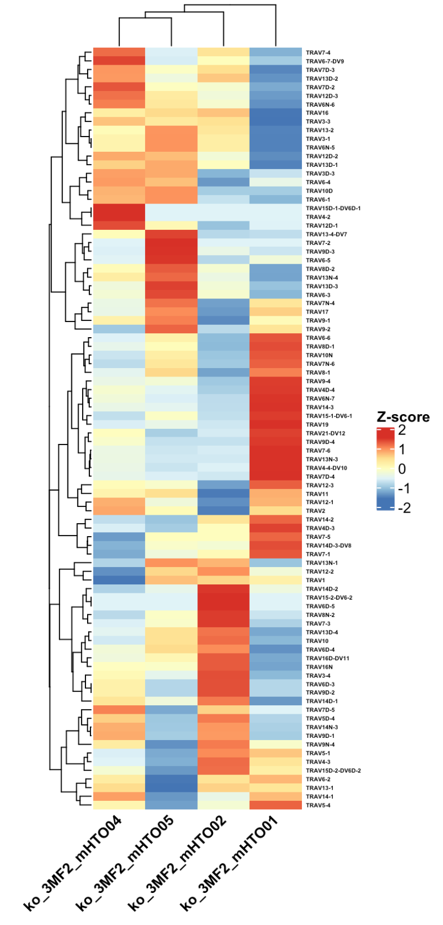

Slide 19
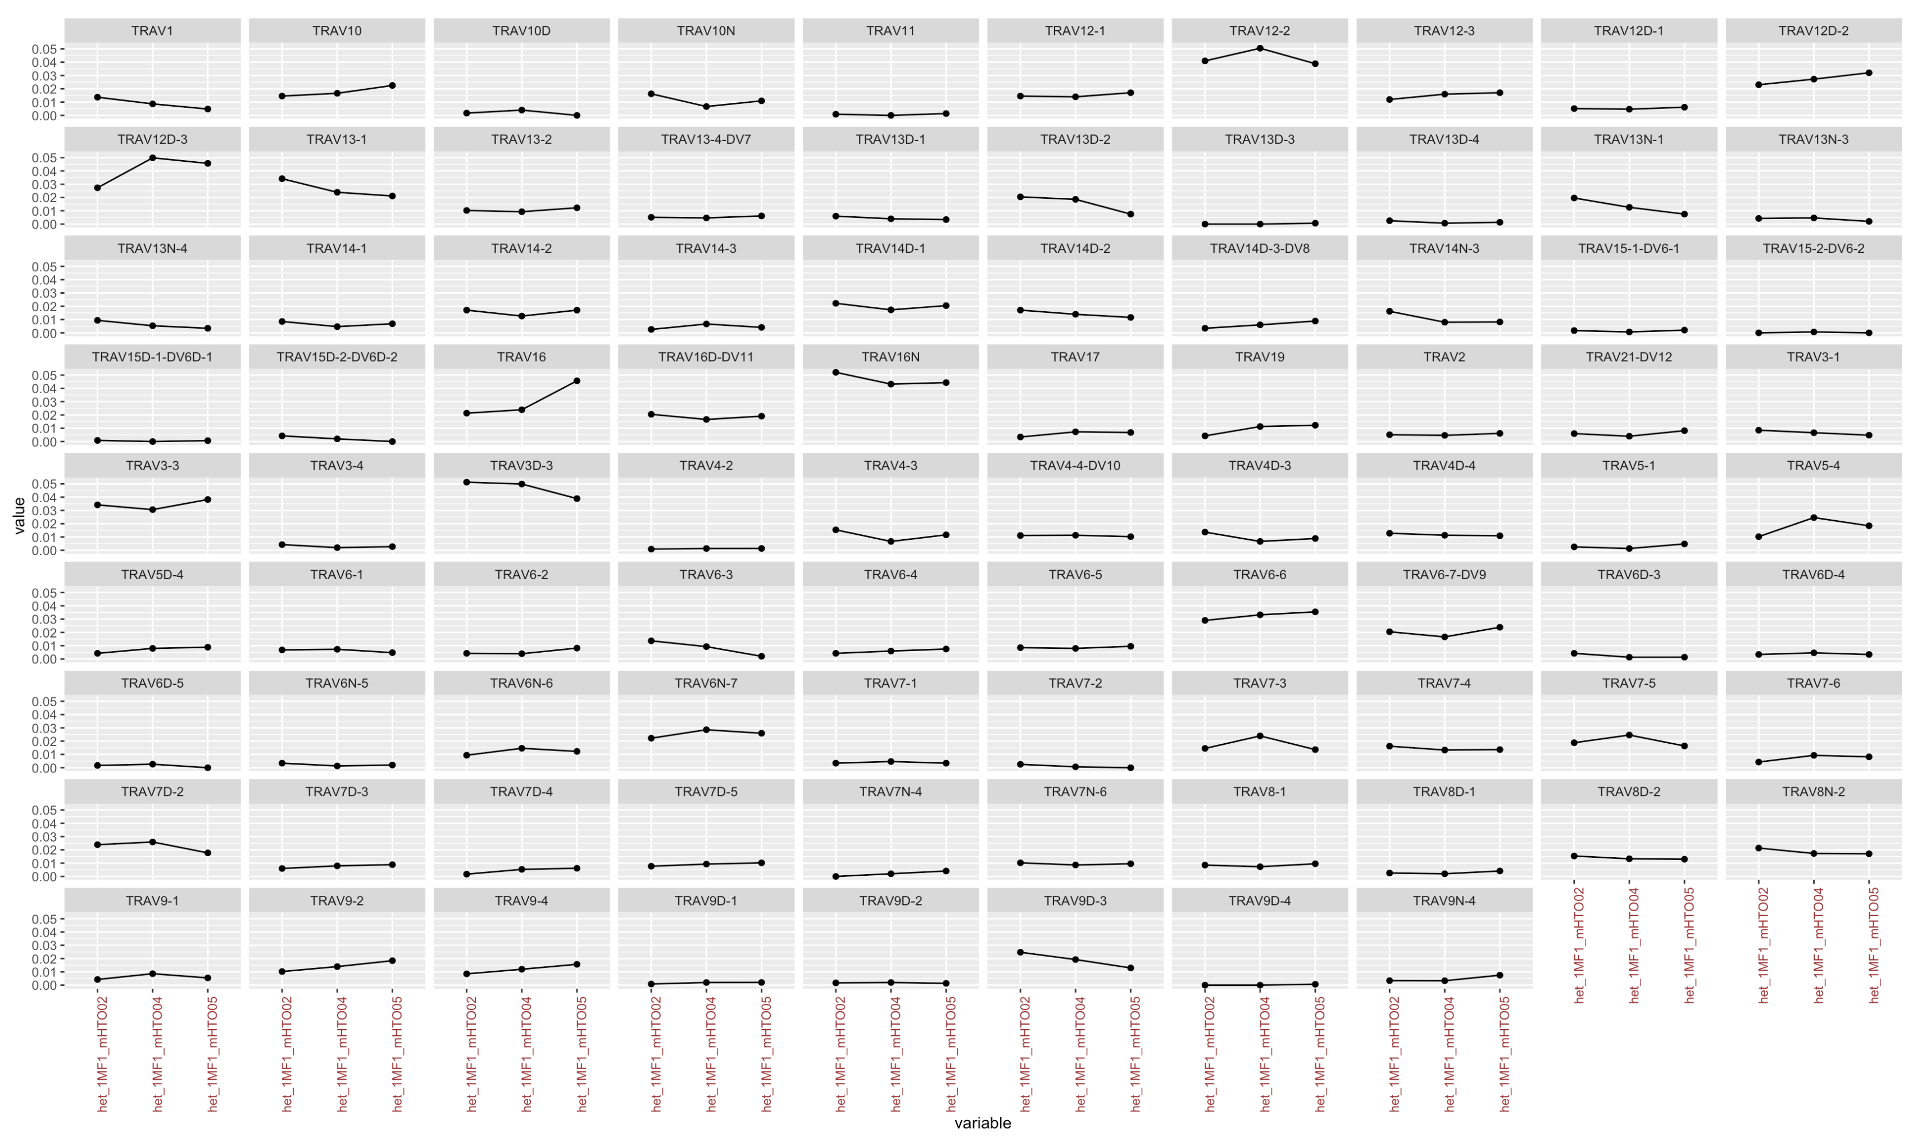

Slide 20
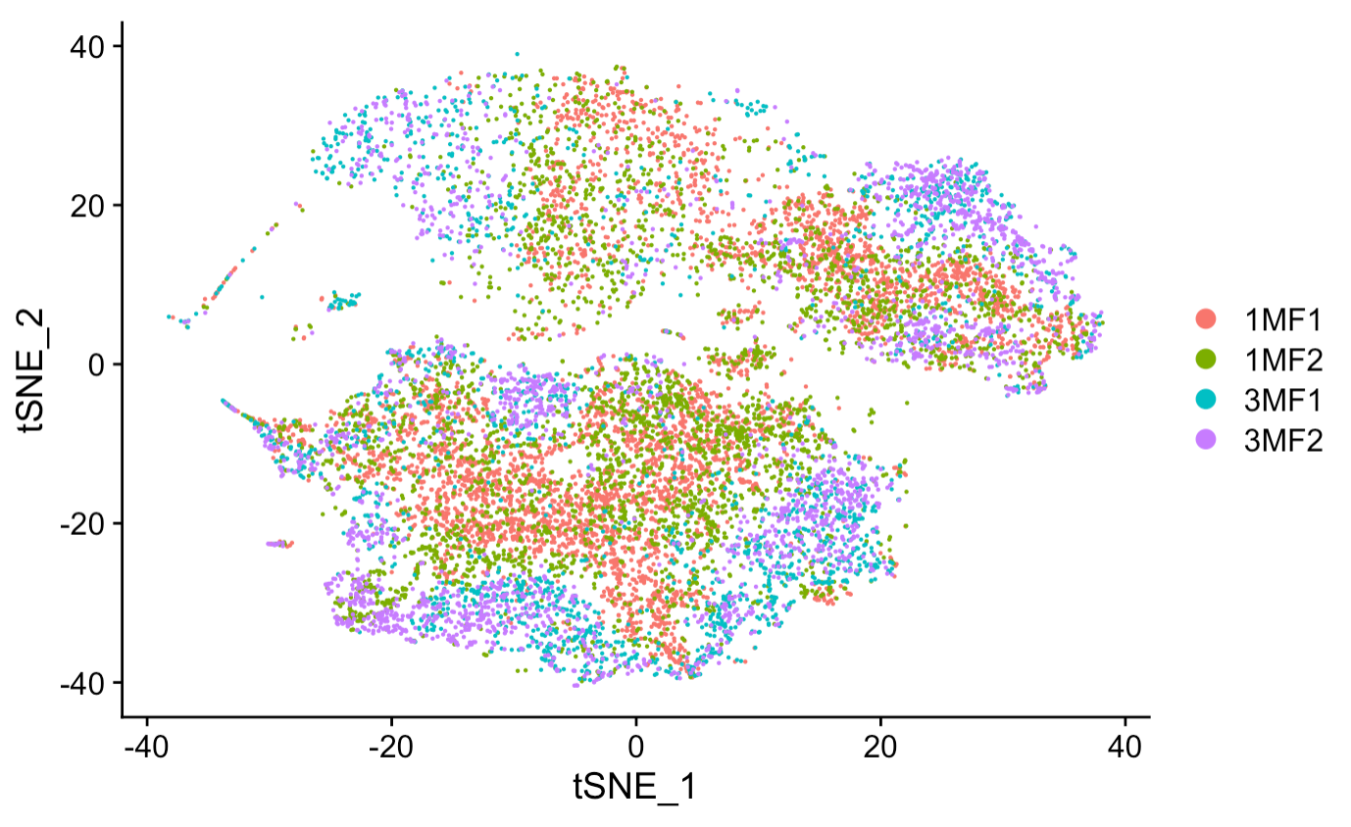
Before (batch correction)
After (batch correction)

Slide 21
TCRa seqences of interest from bulk sequencing
Melina Frantzeskakis
Yousuke takahama

Slide 22
101 unique TCRα sequences are detected in all β5t+/- and not in any β5t-/-
TRAV | CDR3 | TRAJ | Frequency (%)
 |  |  | β5t+/- |  |  |  | β5t-/-
TRAV12N-3 | CALGNYQLIW | TRAJ33 | 0.070 | 0.0004 | 0.029 | 0.009 | 0.000 | 0.000 | 0.000 | 0.000
TRAV14-2 | CAASGMDSNYQLIW | TRAJ33 | 0.065 | 0.026 | 0.016 | 0.001 | 0.000 | 0.000 | 0.000 | 0.000
TRAV12D-2 | CASNTNKVVF | TRAJ34 | 0.013 | 0.001 | 0.021 | 0.044 | 0.000 | 0.000 | 0.000 | 0.000
TRAV4D-3 | CAAVNTEGADRLTF | TRAJ45 | 0.0001 | 0.046 | 0.012 | 0.009 | 0.000 | 0.000 | 0.000 | 0.000
TRAV12N-3 | CALGNNRIFF | TRAJ31 | 0.053 | 0.006 | 0.005 | 0.0001 | 0.000 | 0.000 | 0.000 | 0.000
>0.01
>0.001
>0.0001
=0.0
552 unique TCRα sequences are detected in all β5t-/- and not in any β5t+/-
TRAV | CDR3 | TRAJ | Frequency (%)
 |  |  | β5t+/- |  |  |  | β5t-/-
TRAV13-4/DV7 | CAMEQGGSAKLIF | TRAJ57 | 0.000 | 0.000 | 0.000 | 0.000 | 0.077 | 0.004 | 0.003 | 0.047
TRAV13D-1 | CALEPGYQNFYF | TRAJ49 | 0.000 | 0.000 | 0.000 | 0.000 | 0.021 | 0.036 | 0.035 | 0.008
TRAV13D-4 | CAPMSNYNVLYF | TRAJ21 | 0.000 | 0.000 | 0.000 | 0.000 | 0.031 | 0.028 | 0.018 | 0.021
TRAV13-4/DV7 | CAMESGANTGKLTF | TRAJ52 | 0.000 | 0.000 | 0.000 | 0.000 | 0.0003 | 0.020 | 0.035 | 0.026
TRAV13D-1 | CALETGNTGKLIF | TRAJ37 | 0.000 | 0.000 | 0.000 | 0.000 | 0.001 | 0.045 | 0.022 | 0.004
Shown are unique sequences with top 5 high average frequency
These TCRα sequences, including entire CDR3 and entire VJ sequences, are found only in either β5t+/- or β5t-/- CD8 T cells

Slide 23
TCRα#1 sequence common and frequent in CD8 T cells from 4 β5t+/- mice were rare in CD8 T cells from 4 β5t-/- mice
Gene | Mouse ID | TCR variety | Common TCRs
TCRα | HET1 | 185,984 | 1,360
 | HET2 | 89,540
 | HET3 | 228,899
 | HET4 | 120,044
>1.0
>0.1
>0.01
>0.001
>0.0001
>0.00001
Top 5 highly frequent sequences
Rank | TRAV | CDR3 | TRAJ | Average (%) |  | HET/KO
 |  |  |  | β5t+/- | β5t-/-
1 | TRAV14-2 | CAASASSGSWQLIF | TRAJ22 | 0.42 | 0.70 | 0.60
2 | TRAV14D-3/DV8 | CAASASSGSWQLIF | TRAJ22 | 0.28 | 0.36 | 0.78
3 | TRAV12N-3 | CALSDRYNQGKLIF | TRAJ23 | 0.28 | 1.85 | 0.15
4 | TRAV12N-3 | CALMGYKLTF | TRAJ9 | 0.15 | 0.00002 | 9197.31
5 | TRAV12N-3 | CALSNYQLIW | TRAJ33 | 0.09 | 0.0001 | 65.10
TCRα#1 is highly selective in β5t+/- than β5t-/-

Slide 24
TCRα#2 and TCRα#9 sequences common and frequent in CD8 T cells from 4 β5t-/- mice were less frequent in CD8 T cells from 4 β5t+/- mice
Gene | Mouse ID | TCR variety | Common TCRs
TCRα | KO1 | 188,150 | 3,489
 | KO2 | 226,850
 | KO3 | 145,014
 | KO4 | 264,867
>1.0
>0.1
>0.01
>0.001
>0.0001
>0.00001
Top 5 highly frequent sequences
Rank | TRAV | CDR3 | TRAJ | Average (%) |  | KO/HET
 |  |  |  | β5t+/- | β5t-/-
1 | TRAV12N-3 | CALSDRYNQGKLIF | TRAJ23 | 0.28 | 1.85 | 6.72
2 | TRAV14-2 | CAASASSGSWQLIF | TRAJ22 | 0.42 | 0.70 | 1.67
3 | TRAV13-4/DV7 | CAMEPGANTGKLTF | TRAJ52 | 0.05 | 0.41 | 8.29
4 | TRAV12N-3 | CALSDRYSNNRLTL | TRAJ7 | 0.04 | 0.38 | 9.52
5 | TRAV14D-3/DV8 | CAASASSGSWQLIF | TRAJ22 | 0.28 | 0.36 | 1.29
TCRα#2 are preferred in β5t-/- than β5t+/-

